Slide 1
GDT Portal Architecture
May 2018

Slide 2
Portal Architecture Details

Slide 3
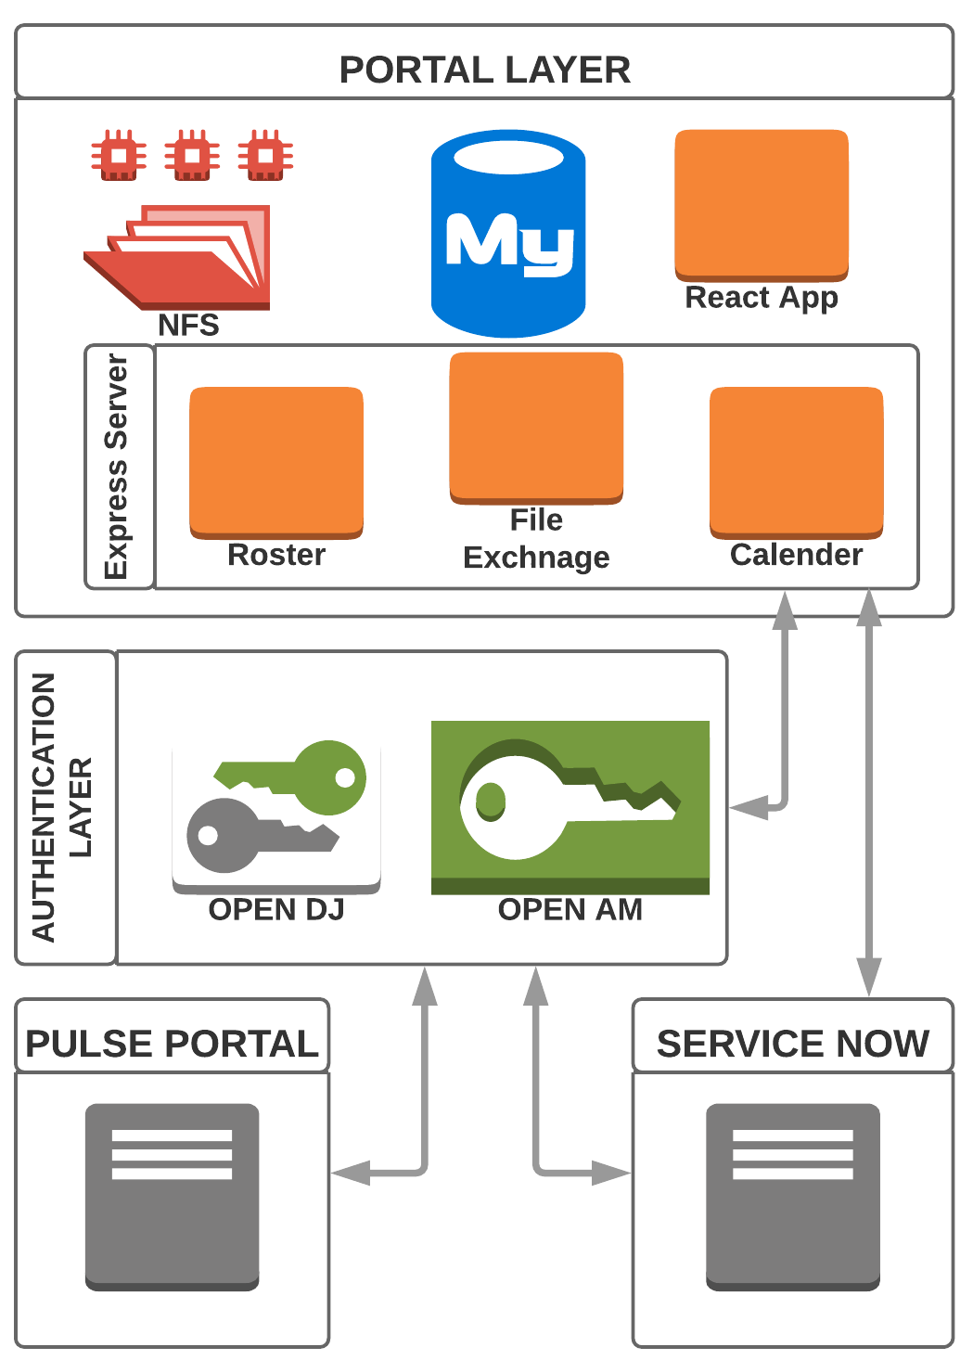
Technical Solution
Components
UI – ReactJS
API Server – NodeJS, ExpressJS
Database – MySQL
File Store - NFS
Authentication – ForgeRock
Open AM
Open DJ(LDAP)
RSA Token base Authentication be configured as a module in OpenAM
Note: This may undergo changes based on answers
and further discussions

Slide 4
Architecture and Sizing
These details are provided with high-level and present understanding, Production architecture will be discussed and finalized
In first 2 weeks of project.
Development
2 Servers/VMs – 4 Cores, 16 GB
Application Server + Database Server
Forgerock (OpenAM + OpenDJ)
Test
4 Servers/VMs – 4 Cores, 16 GB
Application Server
Database Server
Forgerock - OpenAM
Forgerock - OpenDJ
Production (Without High Availability)
4 Servers/VMs – 4 Cores, 16 GB
Application Server
Database Server
Forgerock - OpenAM
Forgerock - OpenDJ
Production Architecture
Connected 50TB storage for VMs
VMWare vSAN storage of 5 TB for files

Slide 5
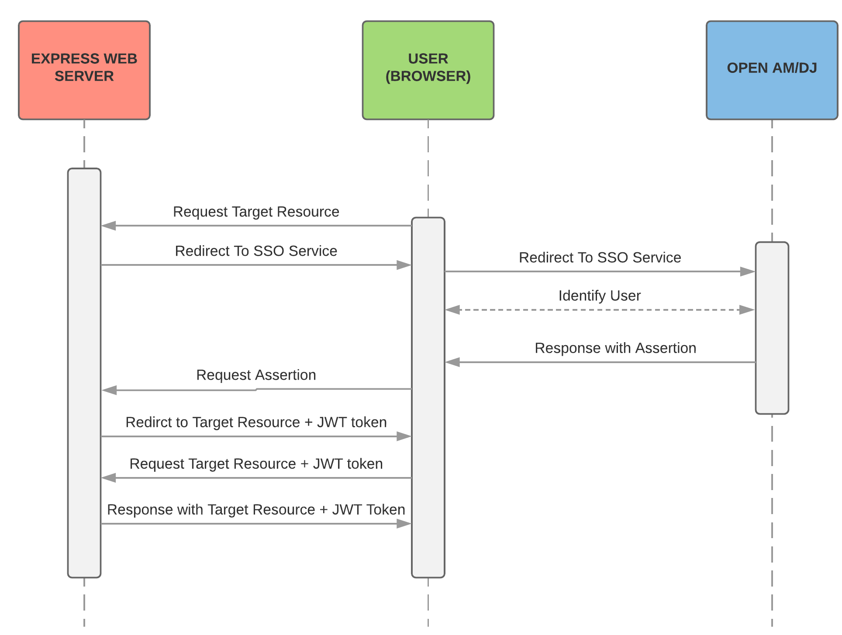
Authentication Flow (SAML2)

